Slide 1
Deep Dive Analysis of Sub-metering Data
ANALYSIS OF ENERGY USAGE HISTORY
IOT Analytics

Slide 2
Project Goal
The aim of this analytical project is to visualize the data and build predictive models that demonstrate how the data can be used to help a home owner make decisions about altering power consumption and to provide immediate value.
This goal has been partially met. Sub-meter 3 in particular can be accurately forecasted, however, separation of elements in Sub-meter 1 and Sub-meter 2 are needed to accurately forecast energy usage.

Slide 3
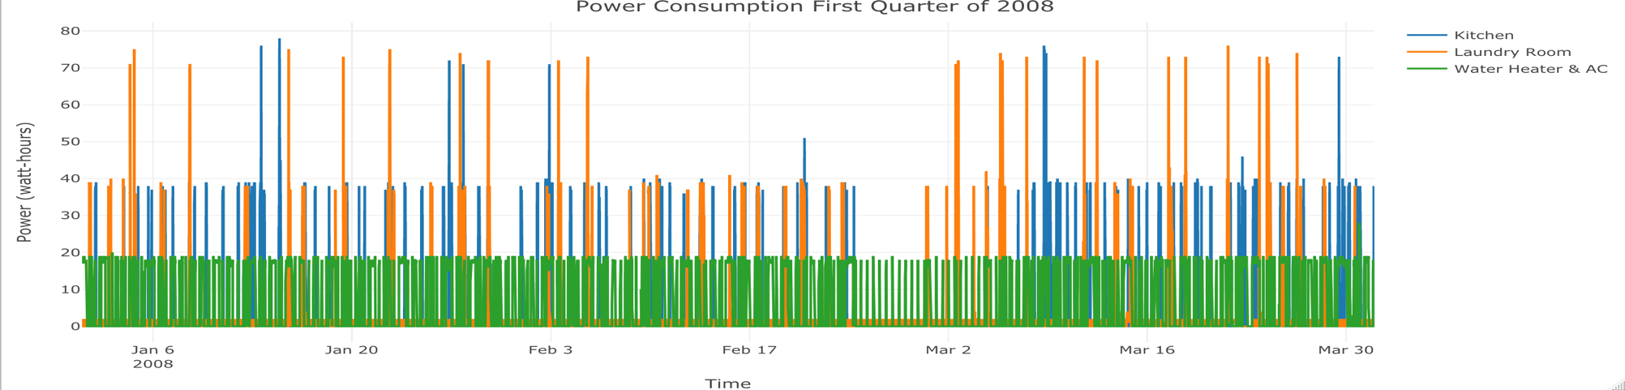
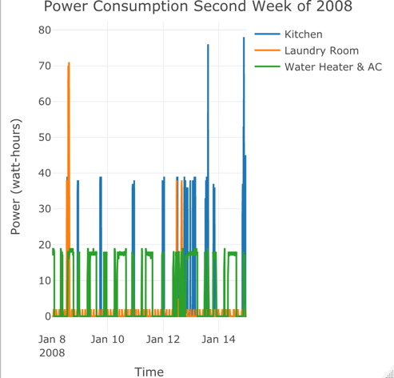
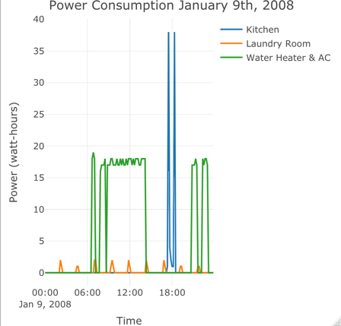
Power Consumption Visualizations: Q1 2008
The 1st Quarter of 2008 exhibits consistent Water Heater usage, with no large spikes. The A/C is likely not in use during winter.
Kitchen and Laundry spike once or twice a week.
Looking at the 2nd week of 2008, Laundry use spikes on Jan. 8, which may indicate washing and drying, whereas on Jan 12 & 14 the kitchen spikes, which may indicate dishwasher use, as half as much energy is used daily, which is likely oven/microwave use.
The daily breakdown shows us the refrigerator is periodically cooling throughout the day; the water heater slightly spikes around 7am indicating bathing followed by what could be heating of radiators; Kitchen usage spikes at 6pm indicating evening meal preparation.

Slide 4
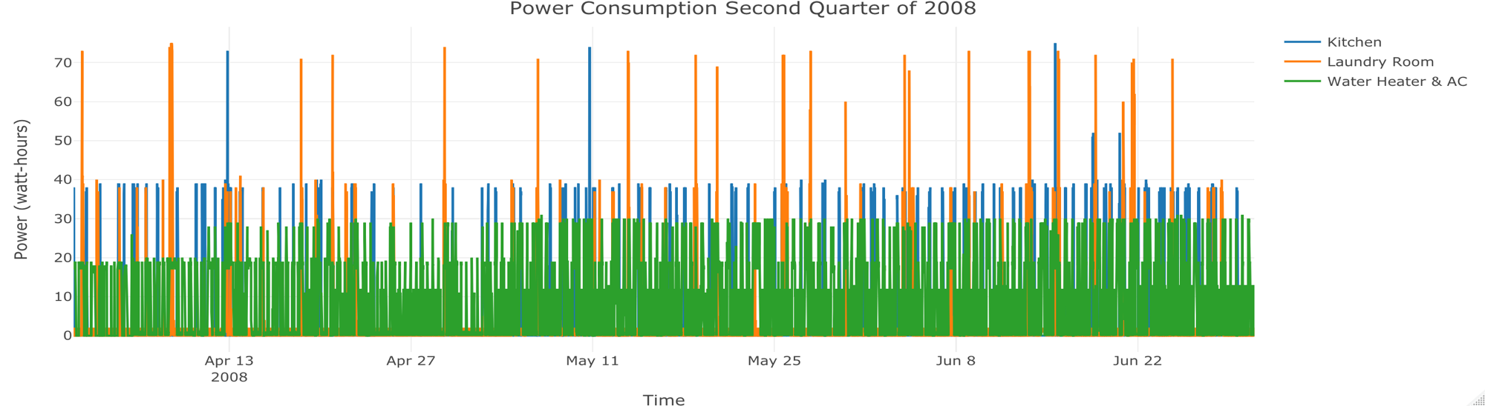
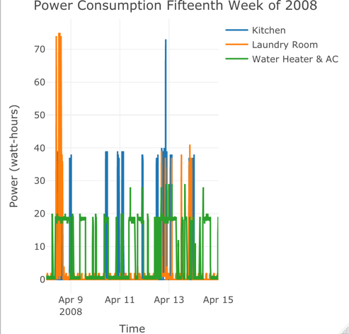
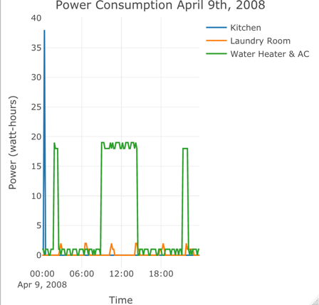
Power Consumption Visualizations: Q2 2008
The 2nd Quarter of 2008 roughly follows the same pattern as Q1, except laundry usage declines. Perhaps more hang drying outside and more A/C usage during warmer periods.
The 1st week of Q2 follows nearly the same pattern as week 2 of 2008, with high laundry usages at the beginning of the week and a spike of kitchen usage in the latter half. Water heater/ A/C remains consistent.
The daily breakdown differs. A midnight spike of energy usage in the kitchen tells me the resident set the dishwasher on delayed start. The first and last Water Heater & A/C spikes could be attributed to bathing while the prolonged midday spikes could be from the A/C cooling during a hot day. Unfortunately, there is no outside temperature recording.

Slide 5
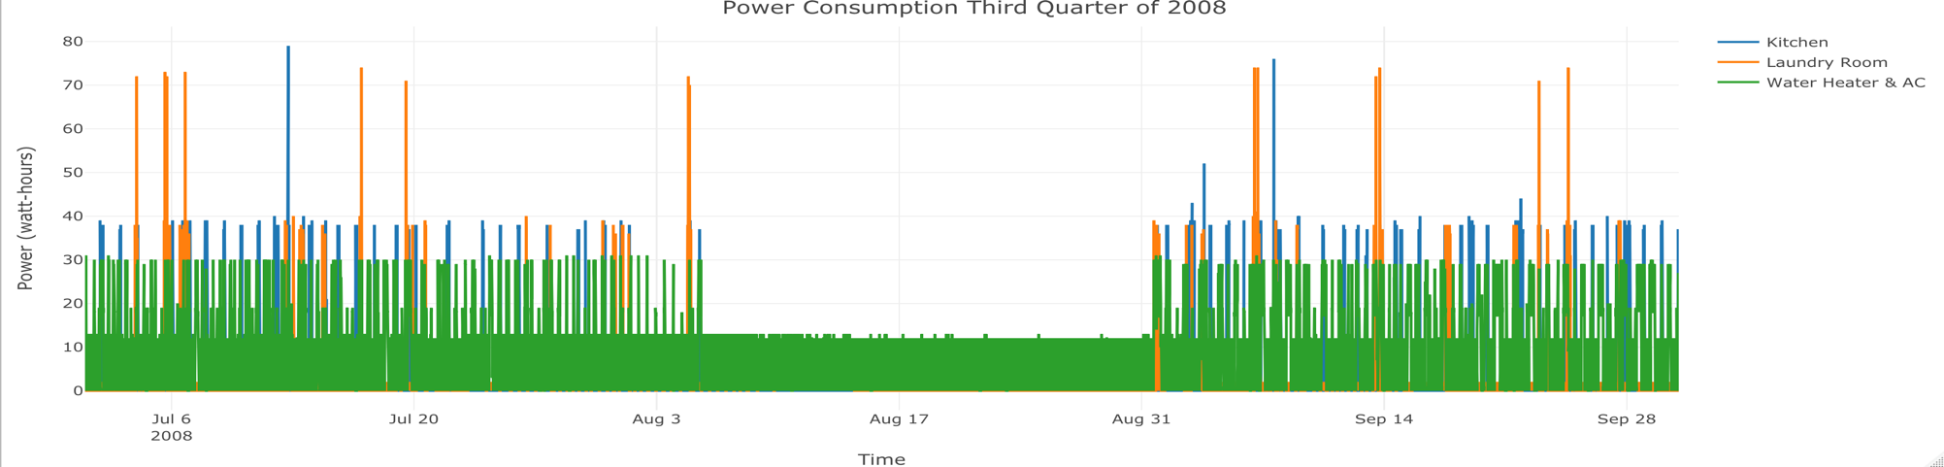
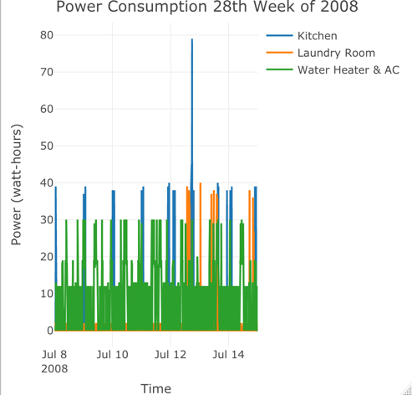
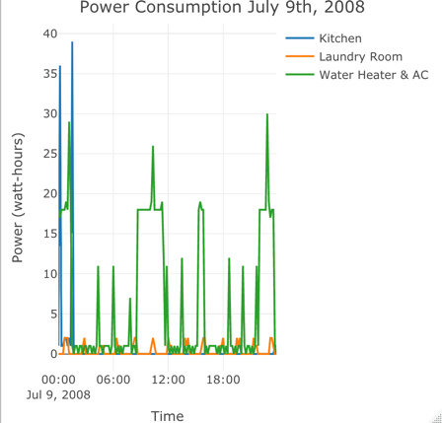
Power Consumption Visualizations: Q3 2008
The 3rd Quarter of 2008 exhibits an absence Kitchen and Laundry use and lower A/C use which likely indicates the resident is away on holiday for nearly a month.
The 28th week of 2008, shows a very high spike in energy usage. Perhaps the resident is using all appliances at once, which is rare. Water-heater & A/C usage is consistently spiking, likely due to cooling the house/apt.
The daily breakdown again shows spiking kitchen use around midnight and high water heater & A/C use midday and a spike at night. The daytime spike is likely due to cooling while the nighttime spike could be due to multiple residents taking consecutive showers.

Slide 6
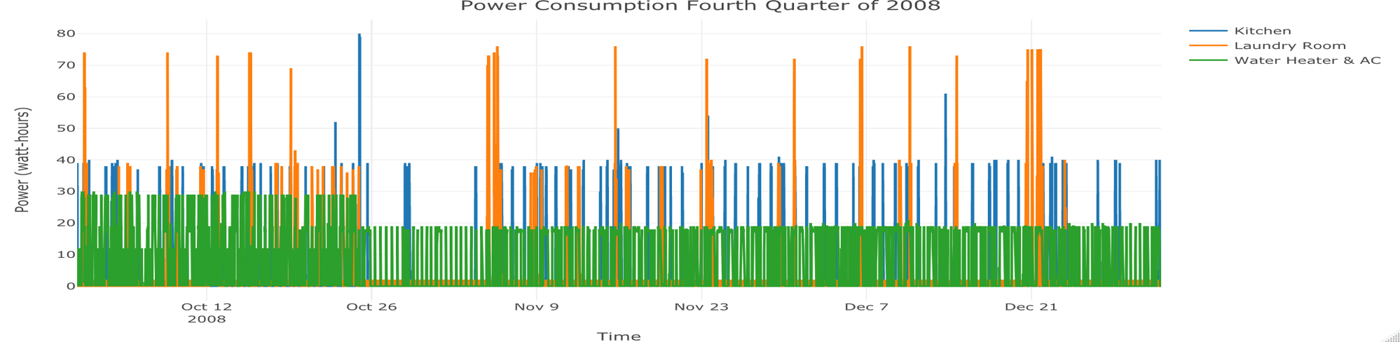
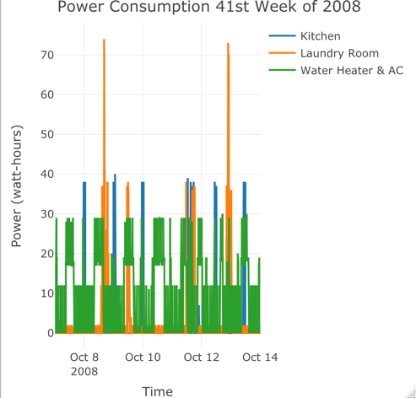
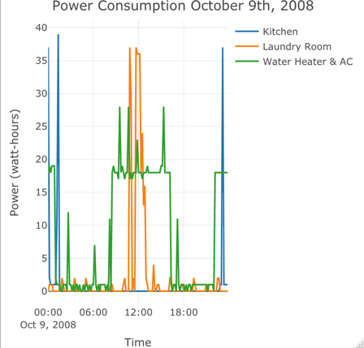
Power Consumption Visualizations: Q4 2008
The 4th Quarter of 2008 shows a drop off in Water heater & A/C usage, likely due to the cooler months. No laundry use was done for about a week. It is possible the resident skipped laundry that week.
The 41st week of 2008 shows moderate use of the water heater & A/C. This usage looks similar to summer months, meaning there could have been an October heat wave. Kitchen and Laundry usage resemble Q2 of 2008 usage.
The daily breakdown shows what looks like delayed start dishwasher use around midnight, A/C cooling mid-day, and washing and drying clothes between noon and 3pm.

Slide 7
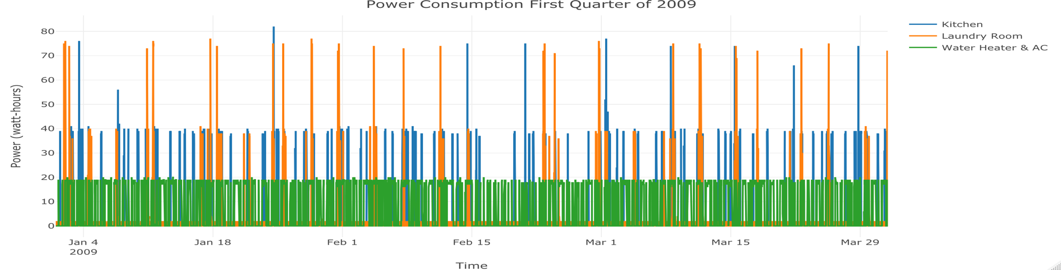
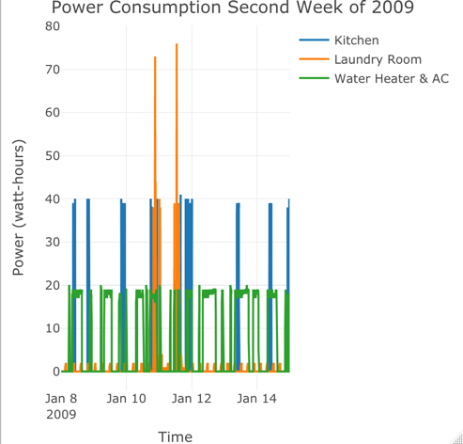
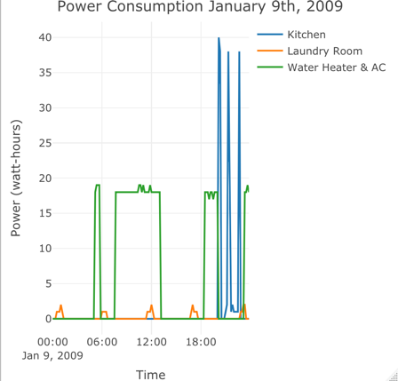
Power Consumption Visualizations: Q1 2009
The 1st Quarter of 2009 closes resembles that of 2008 except Kitchen spikes. This could be due to residents eating with paper plates and plastic sporks; no need to dishwash.
The 2nd week of 2009 resembles the previous year’s 2nd week but no large kitchen spikes. Laundry spikes in the middle of the week as opposed to beginning which is negligible. The Water Heater & A/C looks almost identical.
The daily breakdown is very similar with only an hour or two difference in times of spikes. This most likely does not have a significant meaning. For example, the resident may have started a Karate class in 2009 and he now needs to heat at 7pm instead of 6pm.

Slide 8
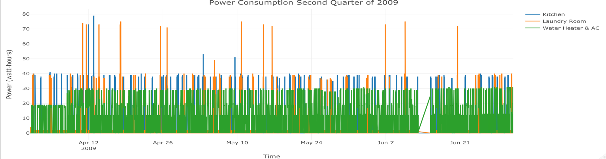
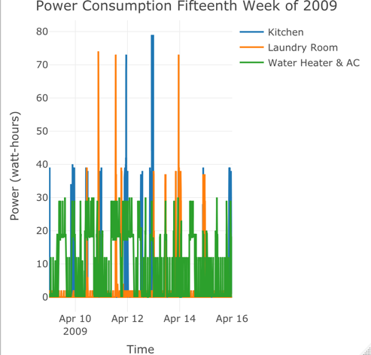
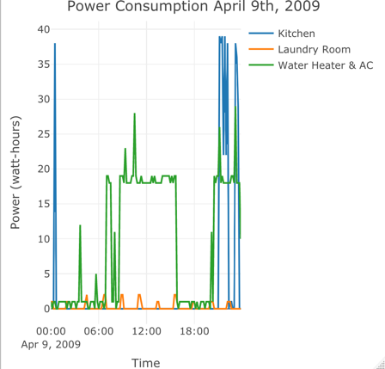
Power Consumption Visualizations: Q2 2009
The 2nd Quarter of 2009 exhibits much less Laundry use than Q2 2008. Possibly due to no rain and hot days, perfect for hang drying clothes. Less Kitchen spikes meaning less dishwashing. A/C usage is similar.
The 1st week of Q2 shows the more Kitchen usage on April 12th & 13th than the rest of Q2. Guest could have been over and two big meals and dishwashing occurred. A/C usage was most likely and a fair amount of laundry done. Possibly washing/drying the guest’s clothing in addition to their own.
The daily breakdown shows a lot of kitchen activity in the evening until just after midnight. It may be due to multiple microwave usage to pop popcorn if movies are being watched, or even delayed start dishwashing. Water heating and A/C spike mid-day when it is the hottest outside, probably due to cooling the residence.

Slide 9
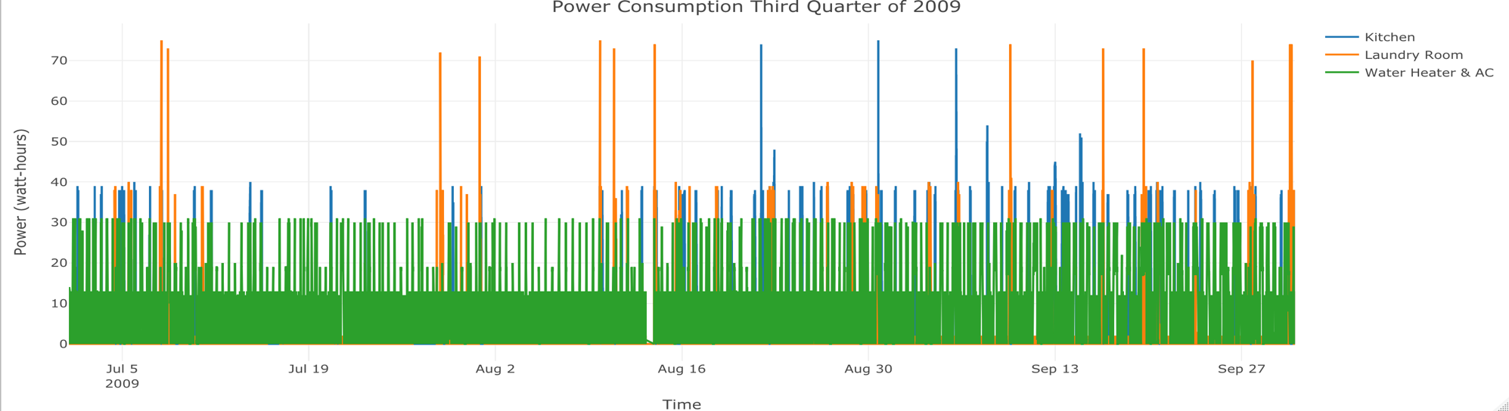
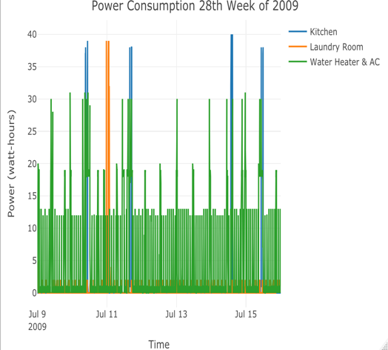
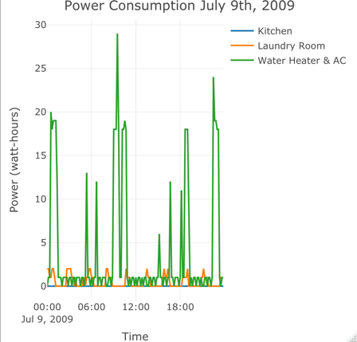
Power Consumption Visualizations: Q3 2009
There is a clear difference from Q3 2009 to Q3 2008. It seems the resident took a shorter holiday of only a week & left the A/C on while away. There is little to no Laundry usage for 2 weeks. Repair may have been needed.
The 28th week of 2009 shows nearly consistent daily spikes in Water Heater & A/C usage, Laundry usage consistent with hang drying, and semi-regular kitchen usage.
The daily breakdown shows only the refrigerator usage in the Laundry room. There is no Kitchen use, but there is Water Heater & AC usage, so the resident is not away. It is likely the resident ate all meals at a restaurant.

Slide 10
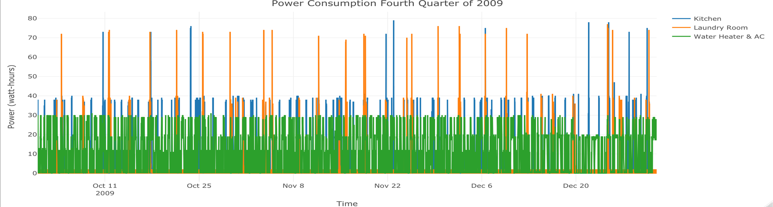
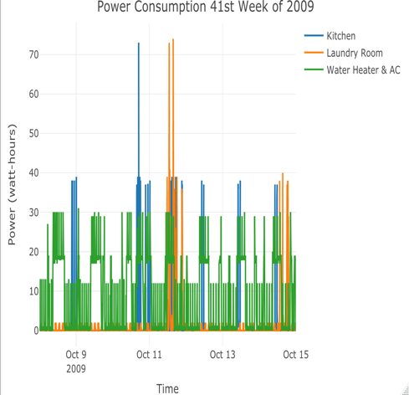
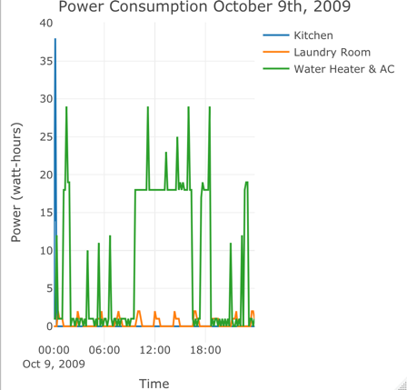
Power Consumption Visualizations: Q4 2009
The 4th Quarter of 2009 looks similar to Q4 of 2008. The resident is using the Kitchen and Laundry regularly, however Water Heater and AC is about 10 watt-hours higher. Possibly due to more residents bathing than before.
The 41st week of 2008 shows Water Heater & AC use on the same level in the hot months. Maybe Q4 of 2009 was an abnormally hot period. However, Laundry use spiked, likely indicating that it rained and the drying was utilized.
The daily breakdown again indicates a delayed start in dish-washing or high microwave usage at midnight. Water Heater & AC usage is similar to the year before, but more early am/late pm spikes, indicating more bathing, perhaps more residents live in the house than did a year before.

Slide 11
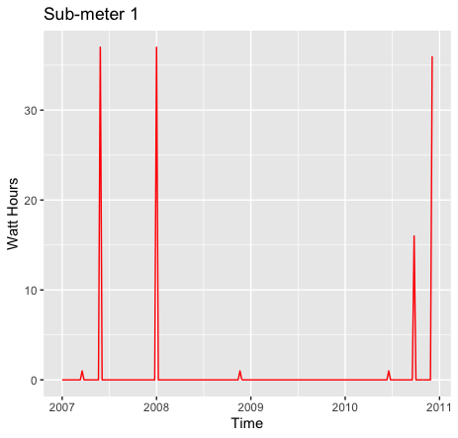
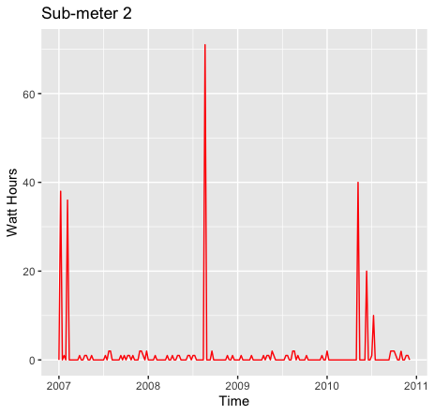
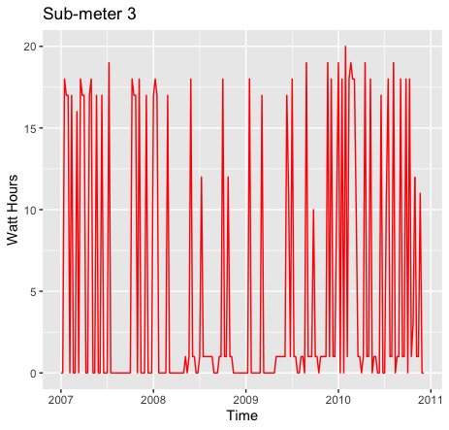
Time Series Visualizations - Weekly
Power consumed in the kitchen on a weekly basis is inconsistent and mostly negligible. With spikes showing cooking and dishwasher use rarely for long periods of time.
The water heater and A/C is by far the most active weekly, with only small drops in usage during warmer months. During those months, the spikes can be attributed to hot water usage.
The laundry room always has consistent power consumption due to the refrigerator's periodic cooling, however spikes for washing and drying clothes are usually not more than once a week.

Slide 12
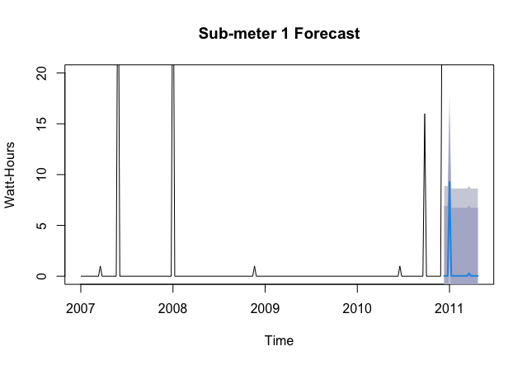
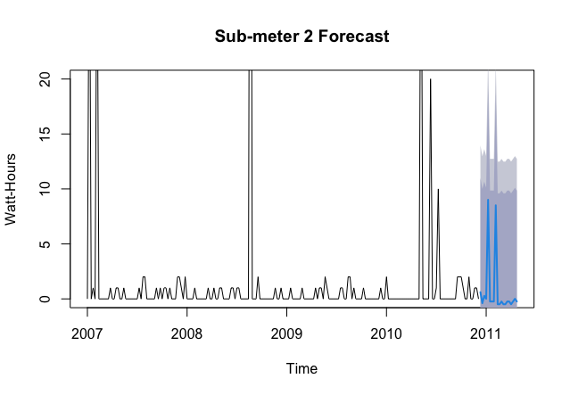
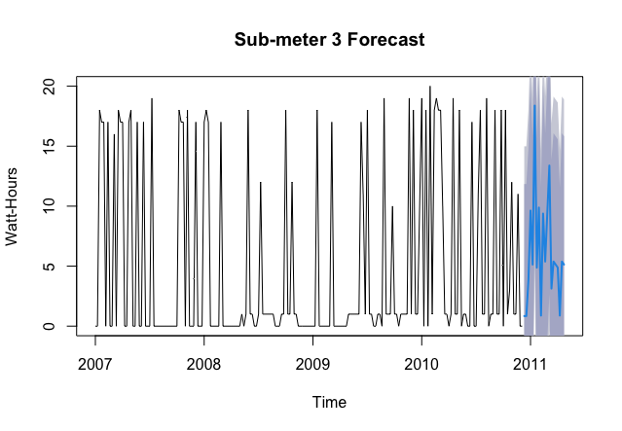
Simple Forecasting
The Sub-meter 1 forecast suggests infrequent and less energy consumption based on 20 weeks of historical data.
The Sub-meter 2 forecast suggests the refrigerator will continue to regular low power consumption with almost bi-monthly power spikes during clothes washing and drying.
The Sub-meter 3 forecast suggests regular moderate to high power consumptions year round with less power consumption doing cold weather periods.

Slide 13
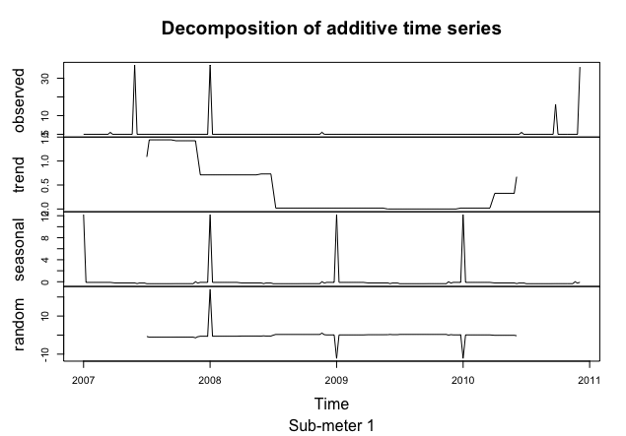
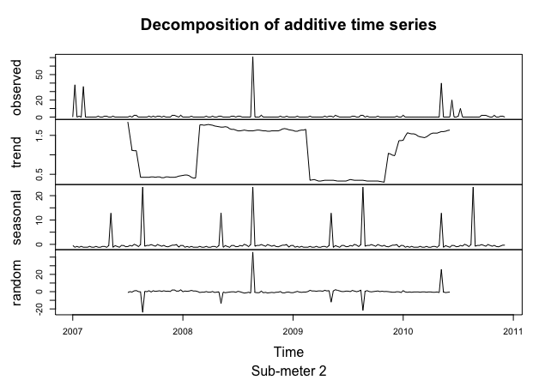
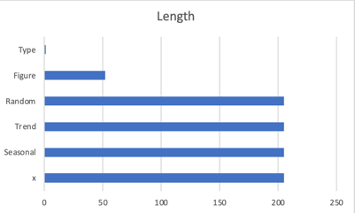
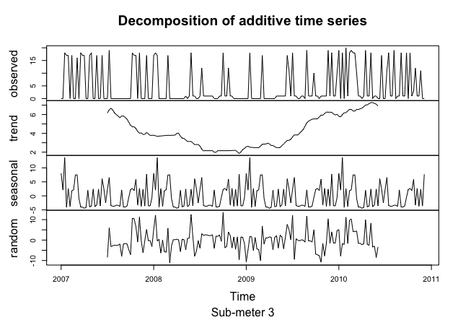
Trend and Seasonality Analysis
Sub-meter 1 does not have any significant seasonality. The kitchen many be used a bit more in the winter than in the summer due to nice weather for eating out, but spikes in power are short-lived. The trend indicates kitchen use steadily decreased from 2008 until 2010, however, there is an uptick in usage in the beginning of 2010.
Sub-meter 2 does not exhibit any significant seasonality. The laundry room may not be utilized for a number of reason, but clothes are usually washed and dried at least once a week. It is possible to see power consumption decrease during warm months is clothes are hang dried. The trend exhibits periods high energy usage followed by low, which repeats.
Statistical Summary for all Sub-meters
Sub-meter 3 clearly exhibits high energy spikes in the winters, which could be attributed to hot baths and showers. Energy is also heavily utilized in the summer when the A/C is used on hot days.

Slide 14
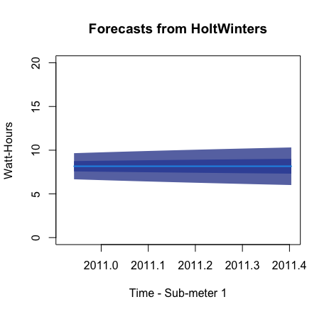
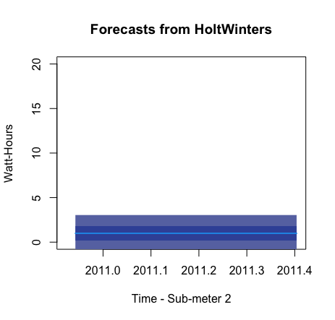
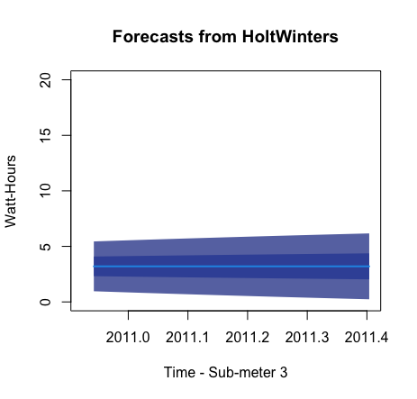
Holt-Winters Forecasting for 25 weeks
Sub-meter 1 is forecasted to use about 8 Watt-Hours with some fluctuations.
Sub-meter 3 is forecasted to used about 1 Watt-Hours with very little fluctuations.
Sub-meter 3 is forecasted to use a little less than 5 Watt-Hours with some fluctuations.

Slide 15
Correlations/Predictions
Sub-meter 1 has weak correlations, but overall, less energy is consumed in summer which most likely indicates more eating out or vacations.
Sub-meter 2 always has energy use due to the refrigerator cooling system periodically running throughout the year. There are less spikes in energy in the summer which could be due to less dryer use in the summer, as hang drying can be utilized. Separating washing/drying from refrigeration would produce better predictions for energy consumption during washing and drying clothes by eliminating the consistent periodic refrigerator’s cooling system.
Sub-Meter 3 has strong correlations to seasonality. Energy usage is high when the A/C is used in warm months, mainly in the Summer or Q3. The water-heater, if also used for radiator heating would increase when it’s cold, however, the A/C usage would be lower, as there is no information whether the using is an HVAC. One can only assume the water heater is used for central heating as well as providing hot-water for showers, sinks, and baths. Regardless, due to seasonality, Sub-meter 3 has the most accurate predictions. Random spikes could be caused by abnormal heat/cold waves, vacations, or accommodating guests.

Slide 16
6 High-Level Recommendations with justifications
Adding household size would provide more insight into energy consumption (how many rooms) *useful for future development projects
Separating electric water heater and a/c would help customers conserve power better
Separating the refrigerator from the washing machine and dryer to eliminate a known semi-constant energy consumption will provide better insights to energy consumption relating to washing and drying clothes
Add a column with outside ambient temperature in order to see spikes in energy consumption due to temperature fluctuations
Creating a separate Sub-meter just for lights could be a good indicators of whether or not a resident is away or if lights are inadvertently left on, this could be factored in to forecasting and predictions
Add a column indicating whether it rained or not; this could be useful in understanding if a resident is hang drying clothes or not when it’s warm outside
Notes:
Do customers in different regions spend more per transaction? Yes, they do.
Which regions spend the most/least? 4 (West) and 2 (South)

Slide 17
Lessons learned
Processing dates requires all features to be numeric, it does not work with Data.numeric
I made more plots than were needed but it raised many more questions
Forecasting always works better when remembering that weather forecasts the future and not the past
I wasted 2 days working on pie charts and ended up not using them; the practice was worth it
Some data collected by sub-meters can be irrelevant to the scope of the project

